Slide 1

Organizational Behavior
(MGT-502)
Lecture-39

Slide 2
Summary of
Lecture-38

Slide 3


Managing Change

Slide 4
The Change Agent’s Role
Change agent - the individual or group who undertakes the task of introducing and managing a change in an organization
The change agent can be internal or external
Notes:
8

Slide 5
Organizational Change
Unfreezing
Changing
Refreezing
Lewin’s Three-Step Process

Slide 6
Today’s Topics

Slide 7
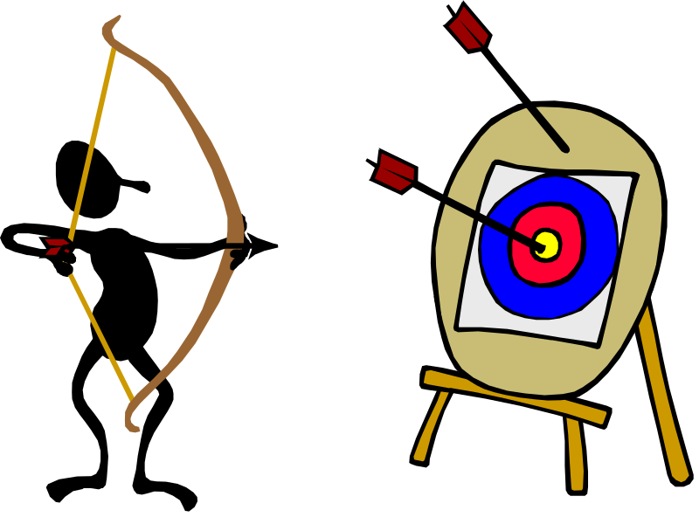
The Challenges of
Organizational Change
Targets for Change
  tasks
  people
  culture
  technology
  structure

Slide 8
Dealing with Resistance to Change
Education and Communication
Participation and Involvement
Facilitation and Support
Facilitation and Agreement
Manipulation and Co-optation

Slide 9
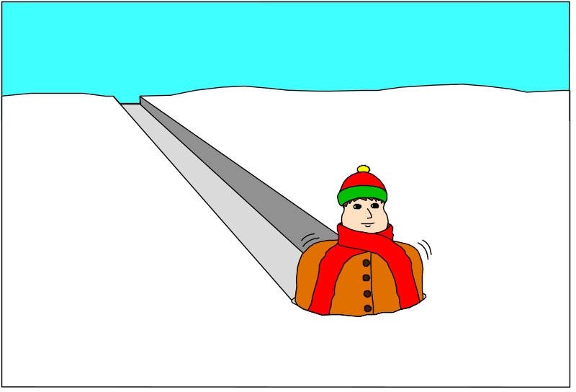
Planned Change
Quick Fix

Slide 10
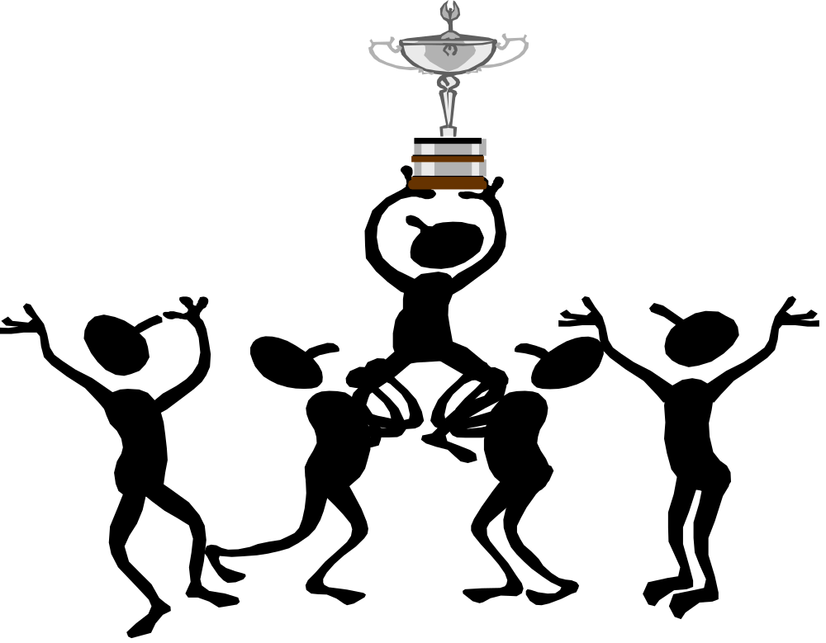
Planned Change

Slide 11

Organizational Development
OD a set of techniques or tools that are used to implement organizational change

Slide 12
Organization Development
Comprehensive approach to planned organizational change that involves the application of behavioral science in a systematic and long range effort to improve organizational effectiveness

Slide 13

Organizational Development Techniques
Sensitivity Training
Training groups that seek to change behavior through unstructured group interaction

Slide 14

Organizational Development Techniques (cont’d)
Survey Feedback Approach
The use of questionnaires to identify discrepancies among member perceptions; discussion follows and remedies and suggested.

Slide 15

Organizational Development Techniques (cont’d)
Process Consultation
A consultant gives a client insight into what is going on around the client, within the client and other people; identifies processes that need improvement.

Slide 16
Organizational Development Techniques (cont’d)
Team Building
High interaction among team members to increase trust and openness.

Slide 17
Team Building Activities:
Goal and priority setting.
Developing interpersonal relations.
Role analysis to each member’s role and responsibilities.
Team process analysis.

Slide 18
Organizational Development Techniques (cont’d)
Intergroup Development
OD efforts to change the attitudes, stereotypes, and perceptions that groups have of each other.

Slide 19
Intergroup Problem Solving
Groups independently develop lists of perceptions.
Share and discuss lists.
Look for causes of misperceptions.
Work to develop integrative solutions.

Slide 20
Organizational Development Techniques (cont’d)
Appreciative Inquiry
Seeks to identify the unique qualities and special strengths of an organization, which can then be built on to improve performance.

Slide 21
Organizational Development Techniques (cont’d)
Quality of Work life (QWL)
Management by Objectives (MBO)

Slide 22
Contemporary Change Issues for Today’s Managers
Stimulating Innovation
Creating a Learning Organization
Managing a Learning Organization
Knowledge Management (KM)
Culture-Bound Organizations

Slide 23

What is Stress?

Slide 24
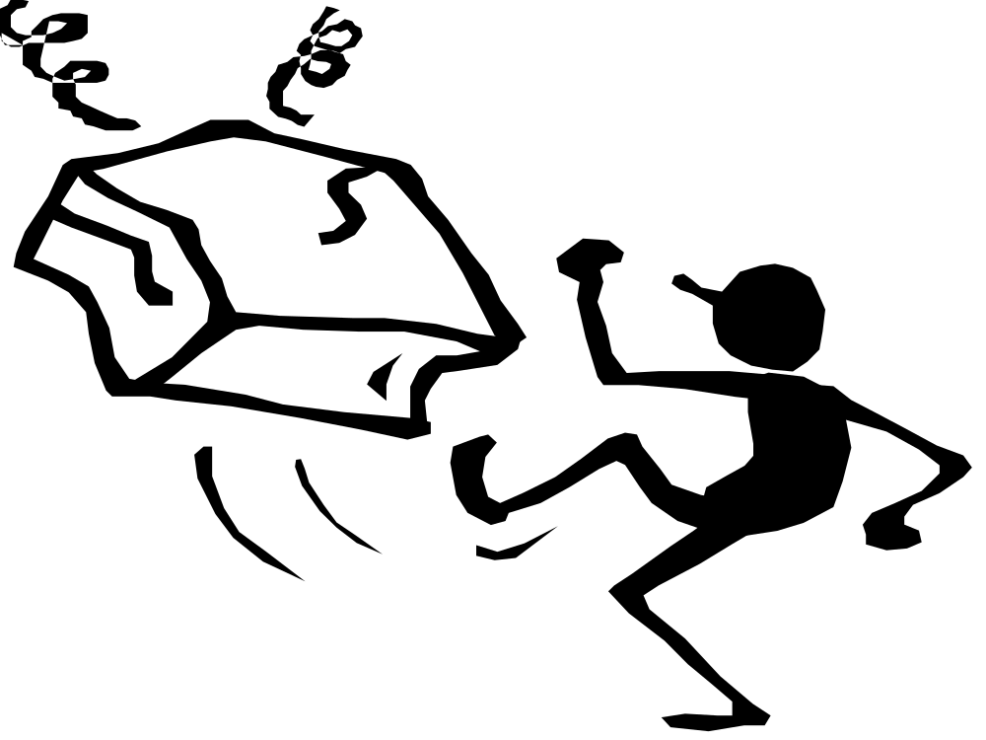

Slide 25


Slide 26


Slide 27


Slide 28


Slide 29



Slide 30
Stress is an adaptive response, moderated by individual differences, that is a consequence of any action, situation, or event that places special demands on a person.

Slide 31
Three key factors determine the likelihood of stress
  Importance: How significant the event is to the person?
  Uncertainty: Degree of clarity over what will happen?
  Duration: Length of time the demands remain in place

Slide 32
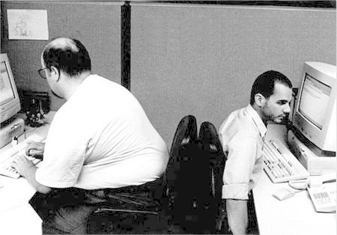

Slide 33

Organizational Stress
Four Ss:
  Supervisor, Salary, Security, Safety
Organizational change
Work pacing
Physical environment
Stress-prone employees

Slide 34
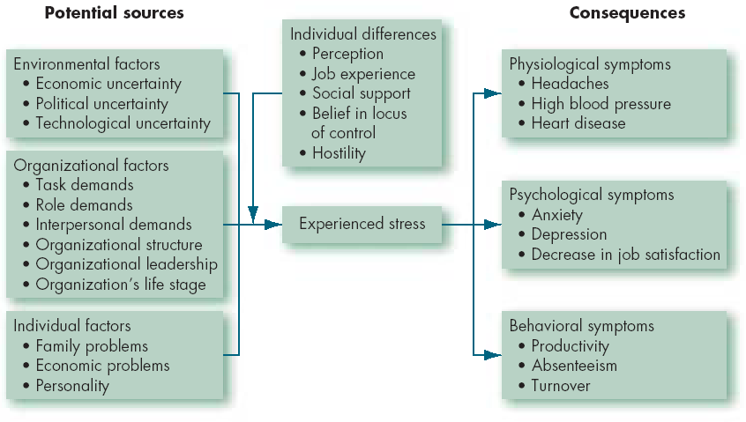
A Model of Stress

Slide 35
Is stress good or bad?

Slide 36
Positive Stress/
Negative Stress
Stress response itself is neutral
Some stressful activities (aerobic exercise, etc.) can enhance a person’s ability to manage stressful demands or situations
Stress can provide a needed energy boost
Negative stress results from
  a prolonged activation of the stress response
  mismanagement of the energy induced by the response
Notes:
12

Slide 37
Relationship between Stress and Job Performance

Slide 38
Stress & Job Performance
Stress can be helpful & harmful
0 stress = low challenge, and performance matches this
As stress increases so does performance until plateau occurs
Over this limit performance declines
Each person has a different threshold

Slide 39
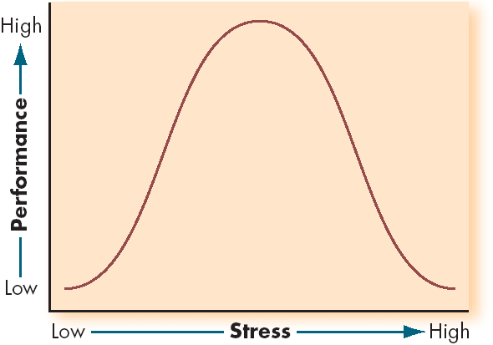
Inverted-U Relationship between Stress and Job Performance

Slide 40
Eustress and Distress
Eustress
Distress
Positive
Reaction to Stress
Negative
Very Low
Very High
Stress Level

Slide 41
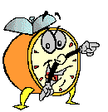
Let’s stop it here

Slide 42
Summary

Slide 43
Planned Change

Slide 44
Organizational Development
OD a set of techniques or tools that are used to implement organizational change

Slide 45
Contemporary Change Issues for Today’s Managers
Stimulating Innovation
Creating a Learning Organization
Managing a Learning Organization
Knowledge Management (KM)
Culture-Bound Organizations

Slide 46
What is Stress?

Slide 47
A Model of Stress

Slide 48
Inverted-U Relationship between Stress and Job Performance

Slide 49
Next….

Slide 50
Organizational Behavior
(MGT-502)
Lecture-39

